Slide 1
Amazon sales performance dashboard
Task 4: Dashboard Design · amazon Sales Dataset · Power BI
ELEVATE LABS · DATA ANALYTICS INTERNSHIP
SUBMITTED BY- PRANALI RANJANE

Slide 2
Project overview Task 4 — Dashboard Design for Business Stakeholders
OBJECTIVE
Design an interactive BI dashboard for business stakeholders to monitor Sales, Profit, and Growth KPIs — enabling data-driven decisions through dynamic slicers, time-series analysis, and summary cards.
DATASET
TOOLS USED
Amazon Sales (Kaggle)
Years – 2020-2024
Power BI Desktop
CSV data source
DAX for measures

Slide 3
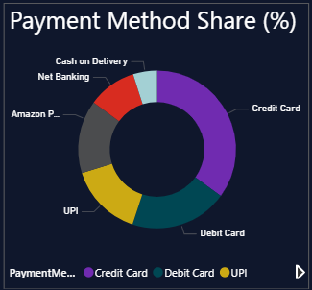
KEY PERFORMANCE INDICATORS
Business Metrics
Total Revenue
Total Orders
Net profit
Profit Margin%

Slide 4
Dashboard Development Process
Data Preparation
Imported Excel dataset
Checked missing values
Removed inconsistencies
Validated data types
Power BI Development
Created relationships
Generated KPIs
Built visual reports
Added filters and slicers
Designed interactive dashboard

Slide 5
Dashboard Story & Key Business Insights
This dashboard tells the story of Amazon's sales performance over 5 years, helping business stakeholders quickly identify:
Revenue & Profitability Trends — How sales and margins evolved year over year
Top Performing Categories — Which product categories drive the most revenue
Geographic Insights — Top states contributing to overall revenue
Payment Behaviour — How customers prefer to pay (UPI, card, COD, etc.)
Order Volume Patterns — Seasonal or monthly order trends

Slide 6
Dashboard Features
KPI Cards — Total Revenue, Net Profit, Total Orders, Profit Margin (%)
Line/Bar Charts — Sales trends over time
Category-wise Sales Breakdown
Payment Method Distribution (Pie/Donut Chart)
Top States by Revenue (Bar Chart)
Interactive Filters — Date, Category, Country slicers

Slide 7
BUSINESS RECOMMENDATION
Based on the dashboard insights:
Regional Growth Focus
Category Optimization
Digital Payment Adoption
Profit Margin Improvement
Seasonal Campaigns

Slide 8
CONCLUSION
OUTCOME- The Power BI dashboard successfully transformed raw Amazon Sales data into actionable business insights.

